Slide 1

Group 3 Evaluation Report
Nathan Ellison, Osbert Garza, Stacey Havel, Tony Jerod-Eddie, Angie Mccormick

Slide 2
Purpose of the evaluation
Examine the efficacy of the current communication links created between faculty, staff, and administration by the Engineering Staff Advisory Council.
Determine which of their four purposes (facilitate communication, empower staff employees, enhance their work environment, and build a sense of community) is experienced by the community as the strongest and which of these purposes are weaker and therefore needing specific attention.
Determine what alterations are needed in order to better achieve its four-fold purpose
Identify any additional needs that have arisen since the inception of the council in 2014 and provide potential solutions.

Slide 3
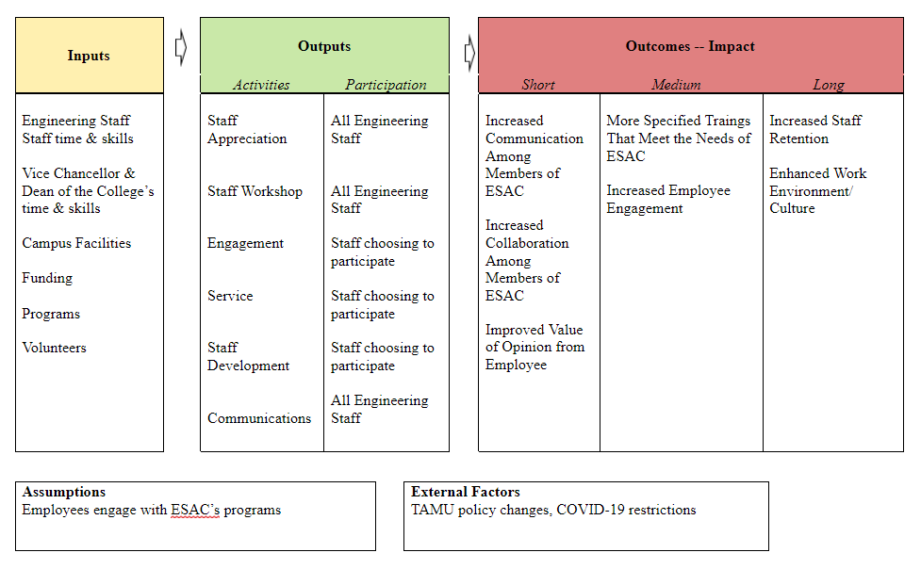
Logic Model of Evaluation

Slide 4
Key questions
Of ESAC’s four purposes (facilitate communication, empower staff employees, enhance their work environment, and build a sense of community) which do you feel has the strongest buy-in? Which has the least buy-in? Why?
To what extent has ESAC contributed to greater institutional outcomes for engineering students?
How has ESAC contributed to your sense of community?
In what ways has ESAC changed the way you communicate with other faculty, staff, or administration in the department of engineering?
Do you feel there is clear communication between ESAC and staff? What have been the largest errors in ESAC communication?
In what way has the program produced or contributed to the intended outcomes set forth by ESAC for engineering staff members?
How has the ESAC continued to influence relational harmony between engineering staff members and heads of the engineering department? What are some tangible examples?
How has ESAC had an impact on how effectively engineering staff members are supported from the vice chancellor and deans office through the work of the ESAC?

Slide 5
Methodology
A mixed methods approach: research in which the investigators collects and analyzes data, integrates the findings, and draws inferences using both qualitative and quantitative approaches or methods in a single study or a program of inquiry” (Russ & Preskill, 2009, p. 261)
Questionnaires
  Cost and time effective
  Socially distant
  Anonymity
Distributed
  To ESAC members and employees in the College of Engineering and TEES

Slide 6
Results
Quantitative
62.5% Agree ESAC needs to improve communication among different levels.
25% Strongly Agree and 62.5% Agree ESAC contributes to the participants sense of community.
87.5% Agree ESAC has met the intended outcomes for engineering staff members.
Qualitative
ESAC’s employees felt the strongest buy-in was empowering staff employees.
The majority of the respondents indicated they feel communication needs to improve.
  The need to improve email communication.
  Too much communication via email, which makes the urgent matters get overlooked.

Slide 7
Results
Qualitative (cont.)
All of the respondents indicated ESAC contributed to institutional outcomes for engineering students.
Respondents feel ESAC changed the way they communicated with others by helping them meet and interact with various departments they would not otherwise.
Majority feel ESAC does not influence the relationship between engineering staff and heads of departments.
  Bring awareness to various positions, but nothing in terms of “relational harmony.”

Slide 8
Conclusion
Survey results presented the strongest purpose experienced, by the ESAC community, to be “empowering staff employees” while having “facilitating communication” as the weakest.
  Organization understands the need to empower their staff, but is failing to upkeep a robust exchange of information across departments.
The results revealed the organization is able to meet their intended outcomes.

Slide 9
Recommendations
ESAC Weekly Newsletter
  Newsletter would contain important dates and information needed to be distributed out to the staff for the week.
  Would eradicate crowded email and easier flow of information
Monthly 1 on 1 Meetings
  Meetings would establish comfortable environment to let staff share concerns about ESAC and any improvements needed.
  Leaders would assess staff members level of content with current organizational practices.
  Would develop stronger relationships between administrations and their staff
Accountability Touchpoints
  Touchpoints would follow-up on topics, discussed in previous 1 on 1 meetings that needed attention, to see how they are/were handled.
  Creates positive work environment focused on cultivating the culture around them

Slide 10
References
Engineering Staff Advisory Council. (2021). https://engineering.tamu.edu/information/esac/index.html
Fraenkel, J. R., Wallen, N. E., & Hyun, H. H. (2016). How to Desgin and Evaluate Research in Eduation, 9th edition. New York City: McGraw-Hill Education.
Russ-Eft, D., & Preskill, H. (2009). Evaluation in organizations: A systematic approach to enhancing learning, performance, and change. Perseus Publishing.

